Slide 1
TIMING/VIDEO
Remove auto-advancing after creating a video version:
On/Off:
In the tabs (not menu): “Slide Show”
[X] Play Narrations
[X] Use Timings
[ ] Show Media Controls
Clear the timings completely:
Select all the slides
Right click a slide > “Slide Transition…”
In the “Advance slide” section uncheck “Automatically after”
NOTHING LONGER THAN 20 minutes!
The complete guide to Designing Mobile User Experiences 6) Information Architecture
@shoobe01
4ourth.com
Notes:
Now that we’ve covered the fundamentals of mobiles, user interaction and platforms, we’re actually going to back up a step and start working through the design process.
First, a step you should start doing before you actually identify the platforms to build.

Slide 2
Information Architecture
Notes:
Information Architecture is a term or concept you may have heard. You may have used it. And you may have mis-used it, so I have to talk about it a bit even if you are an experienced designer already.
IA is the underlying organization, structure and nomenclature that define the relationships between a site’s content/functionality.

Slide 3
Information Architecture
is not just navigation.
Notes:
Navigation communicates to the user where they are and allows access to the features and information on the site or in the app. But it’s an abstraction of the complete structure. IA is not navigation, but the structure you derive navigation from.
IA is not just digital, or just about one channel. You can do a lot of IA work before you have settled on a platform. I often do that, and use the structure to help define what features go on which platform. Or even to make informed choices about the platform needs.
Information architecture is not about the UI, but the users, their expectations and experiences.

Slide 4
“Error is viewed, therefore, not as an extraneous and misdirected or misdirecting accident, but as an essential part of the process under consideration.”
– John VonNeumann
“Error in Logics,” 1952
Notes:
For a long time, we have assumed computers are infalliable, but long ago they were not, and lately we have realized that in aggregate, there are still problems.
Resilience engineering is something used to keep big, reliable services like Google, Facebook, Etsy, Flickr, Yahoo, or Amazon online. At a deep engineering level they follow practices and procedures to assure their systems are not brittle, and avoid failure or fail gracefully and can be fixed easily even with power failures, network breaks and typhoons.
Resilience is usually defined as the ability of a system to absorb disruptions without tipping over to a new kind of order. A building when exposed to too much lateral ground movement settles into a state of “pile of rubble on the ground” unless you design it to resist this disruption adequately.

Slide 5
Embrace failure and complexity.
Notes:
You can’t prevent these problems, so you have to expect and plan for them.
From our point of view, remember is that everything you do is too complex to adequately model and map. Assume you have always missed something, so you are prepared to deal with the unexpected, both in design and so you can modify your product over time to take advantage of new ways you find people using your information.

Slide 6
Notes:
I say there’s also something called Resilience Design. Here’s a simple example…
Though I love my smartwatches, I also still wear normal dial watches. One is a dive watch, because it’s shiny, not because I am a diver or anything. It is one of those with a twisty ring around the outside. That part with the numbers twists around.
If you don't know, and I didn't until recently, this is used as a simple timer. But on mine, and on all dive watches (vs. Aviators watches), the ring only goes one way. The clicky detent lets it go counter-clockwise, only. WHY? … Because it's for timing remaining air. The ring might get bumped and change it's setting. Having it show less time might be inconvenient, but going the other way might kill you. And, you don't even need to know this. It just works. That's the sort of brilliantly-simple answer I am talking about with resilient design.

Slide 7
There is no happy path.
Notes:
You need to make your designs resilient because users will never, ever do what you expect. You, or others in your organization, probably draw diagrams that assume everyone starts at the home page, drills down through a preferred path and gets their information.
It’s not true. People bookmark, share, and search. They use your process in unexpected ways, and your system returns errors or data you didn’t expect. If you try to design to accommodate these, or to test for them in the traditional use case model, you CAN’T. For one project I worked on, I did some quick math and to create the use cases for all variations would take approximately the remaining life of the universe.
Really.
These are arbitrarily complex products, so don’t lament, embrace the complexity.

Slide 8
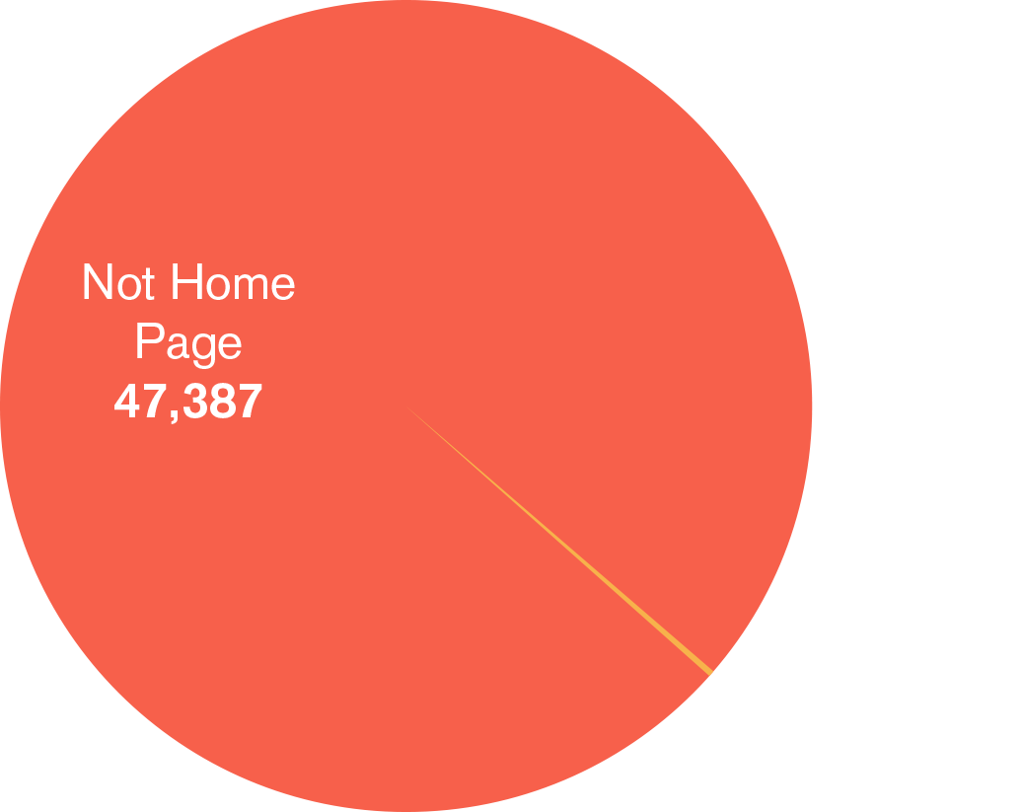
Notes:
And this happens before they even get to you. On a typical website, I find that home page as the entry point is rarely over 10%, and is often so low as to be ignored; hundreds of visits a month when hundreds of thousands visit the site.
This chart is real data and is typical of many clients I work for.

Slide 9
Information snacking &
re-engagement.
Notes:
This is even more important with the way people engage on mobile devices. People seek out and consume content sometimes a few seconds at a time. They get interrupted, and come back to read a bit again so it has to be ready for them. Does your information work well and make sense if set aside for a few minutes? A few hours? Make sure session expiry and other technical things don’t get in the way of users coming back.
And, remind them to come back. Use SMS, and app notifications or reminders within the site or app of items that may be interesting or that they didn’t complete. Or emails. Or postcards. Or whatever fits the way you have a conversation with your customers or users.

Slide 10
“I publish a website, but tens of thousands of my most loyal readers consume it using RSS apps. What should they count as, “app” or “web”?
I say: who cares? It’s all the web.”
– John Gruber
@daringfireball
Notes:
Because content and information is how we live and breathe. Where is the content? Wherever the user is. Don’t architect just the website, or the app, but the service that you provide.

Slide 11
“Sadly, no decision about architecture is a decision, one that will determine your success or failure as a company.”
– Michael Sharkey
@michaelsharkey
Notes:
Thinking of systems means thinking about how information works agnostic of channels. It means thinking of Information Architecture, data architecture, even storage technologies and what’s in the API, first.
Think about some really successful products. Twitter, which is SMS based, but you use as a Website, as an app on your computer or handset, or tablet… Or take Evernote. Who used some competing tool to keep track of stuff like that a few years ago? SimpleNote, Springpad, WizNotes, Google Keep, FetchNotes, Onenote, NotionNote, SimpleNote,… ? Well, most of those disappeared or are much smaller. Why? They were great websites. Or apps. On iOS only.
But Evernote is a platform, more than anything. They built not a website or an app but a product around people’s needs to capture, store and retrieve. Their platform even has a name (Trunk) and teams work on that as a product in and of itself.
Thinking of their product as a service meant they could move into new platforms immediately, without re-thinking their business model, or re-architecting their systems. Being user-centric means they made decisions good for their product, and their business instead of what is comfortable or easy to build.

Slide 12
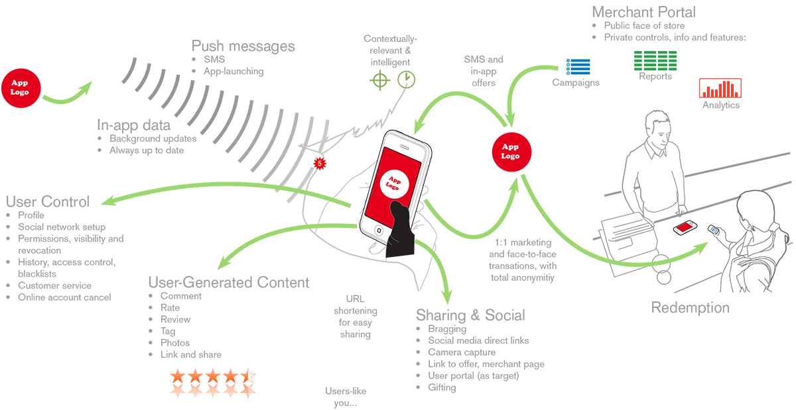
Notes:
So, you need to design like this, and be able to show it off. You need to make Information Architecture documents. There’s much discussion of those if you look at general UX practice, but I (and many others) like to consider the best way is to design truly from the user’s point of view.
Think about them, their motivations, their goals and the real, broader environment. About what they already do with their day. If it is raining, or they are driving vs. walking. Design not just boxes, but arrows. How does the user flow through the system? Or for complexity, how COULD they flow through the system.
There are many ways to draw this. But most of all, make sure you talk about services, data, sensors, networks and USERS. Not screens, pages, buttons.

Slide 13
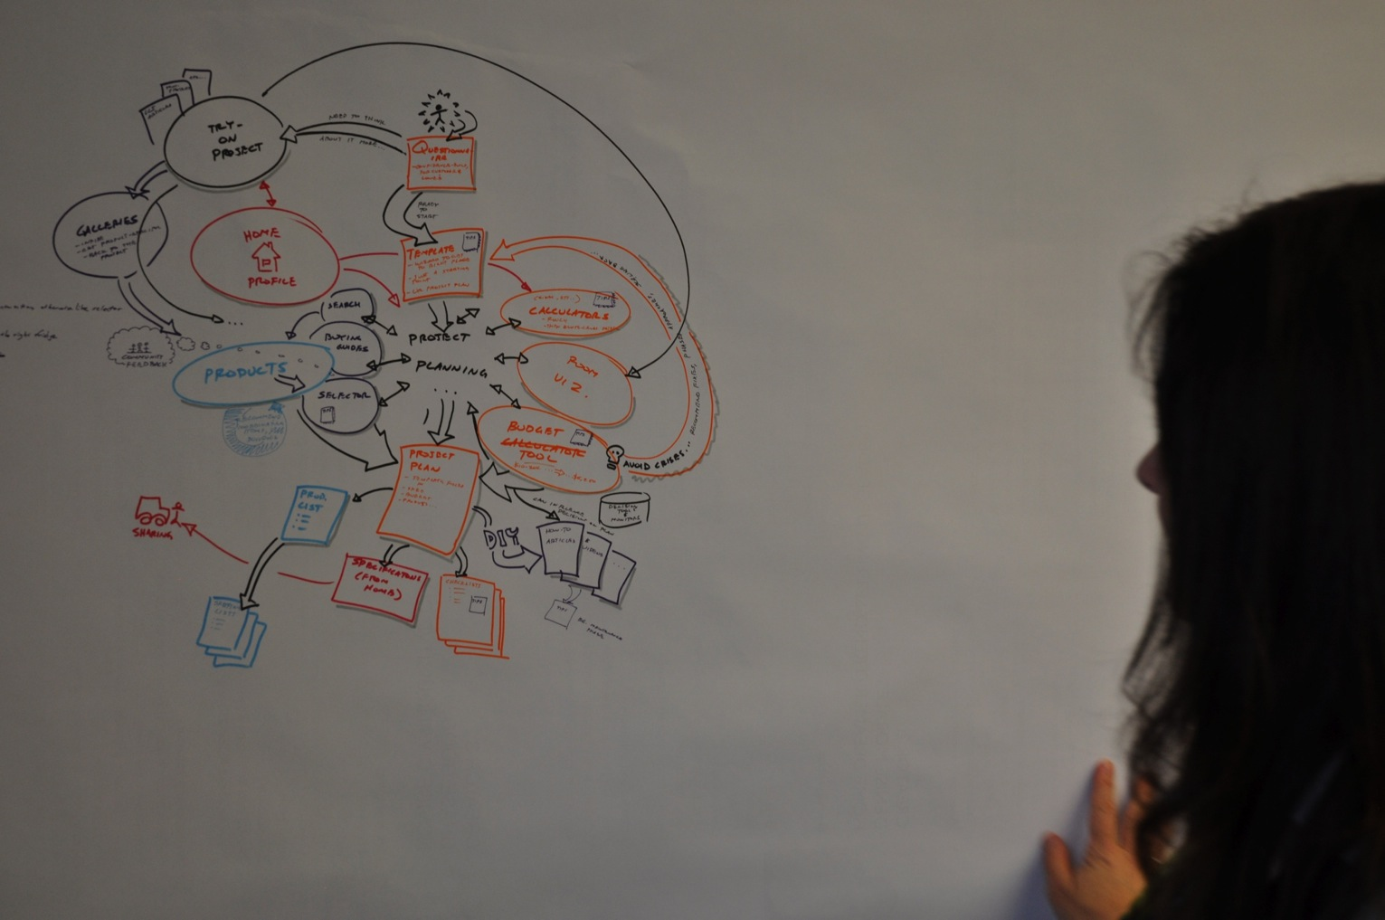
13
Notes:
It doesn’t have to be pretty. Just start with boxes, or even literally take post-its off the wall and start the diagram from whatever else you have done, by gathering requirements from your users or clients.

Slide 14
Notes:
If more comfortable with thinking about the user and their environment directly, this is a good place to use the storyboard.
And, feel free to use several methods. Some of these diagrams I am showing you were from the same project, just different ways of depicting and thinking about the user.

Slide 15
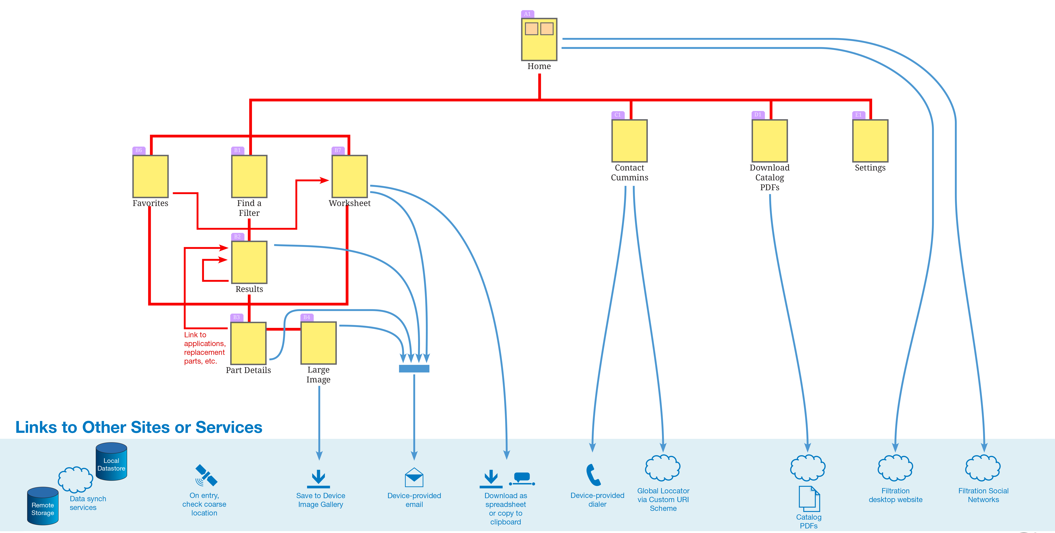
15
Notes:
But you may be wondering, how do we think about data, and systems and connectivity? Well, do that also.
None of this is just about users, or just about any other one facet. Ideally, you never again make a document that disregards other layers of the stack. In this case, your data and interconnectivity is critical.
It might be hard to see, or to make everyone understand that a box is not about UI but process. You may need to extract it more explicitly like this with the row of external data sources and sensors along the bottom.

Slide 16
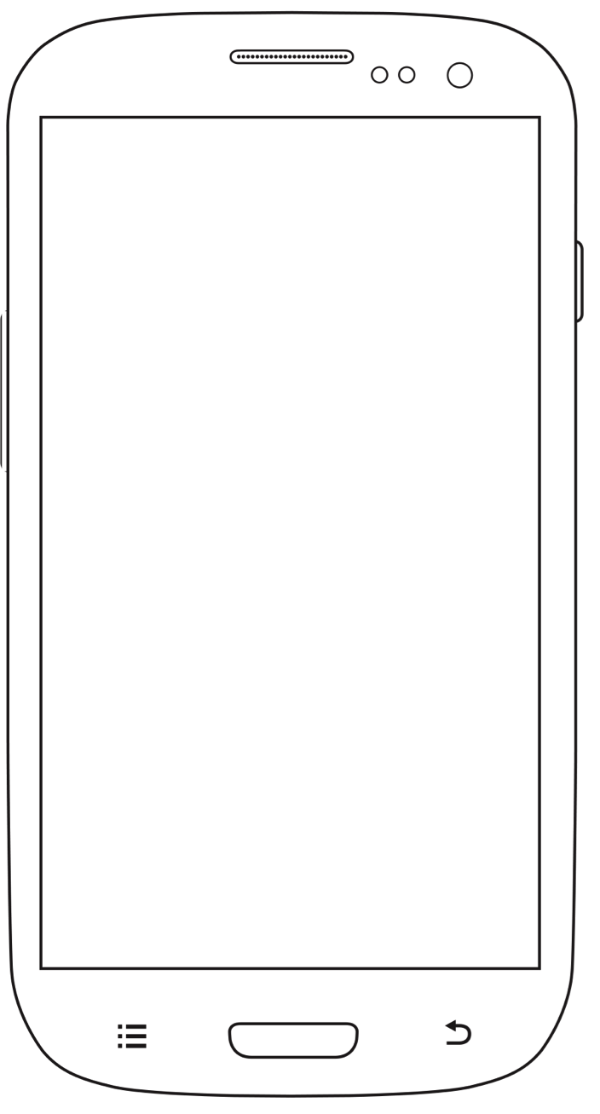
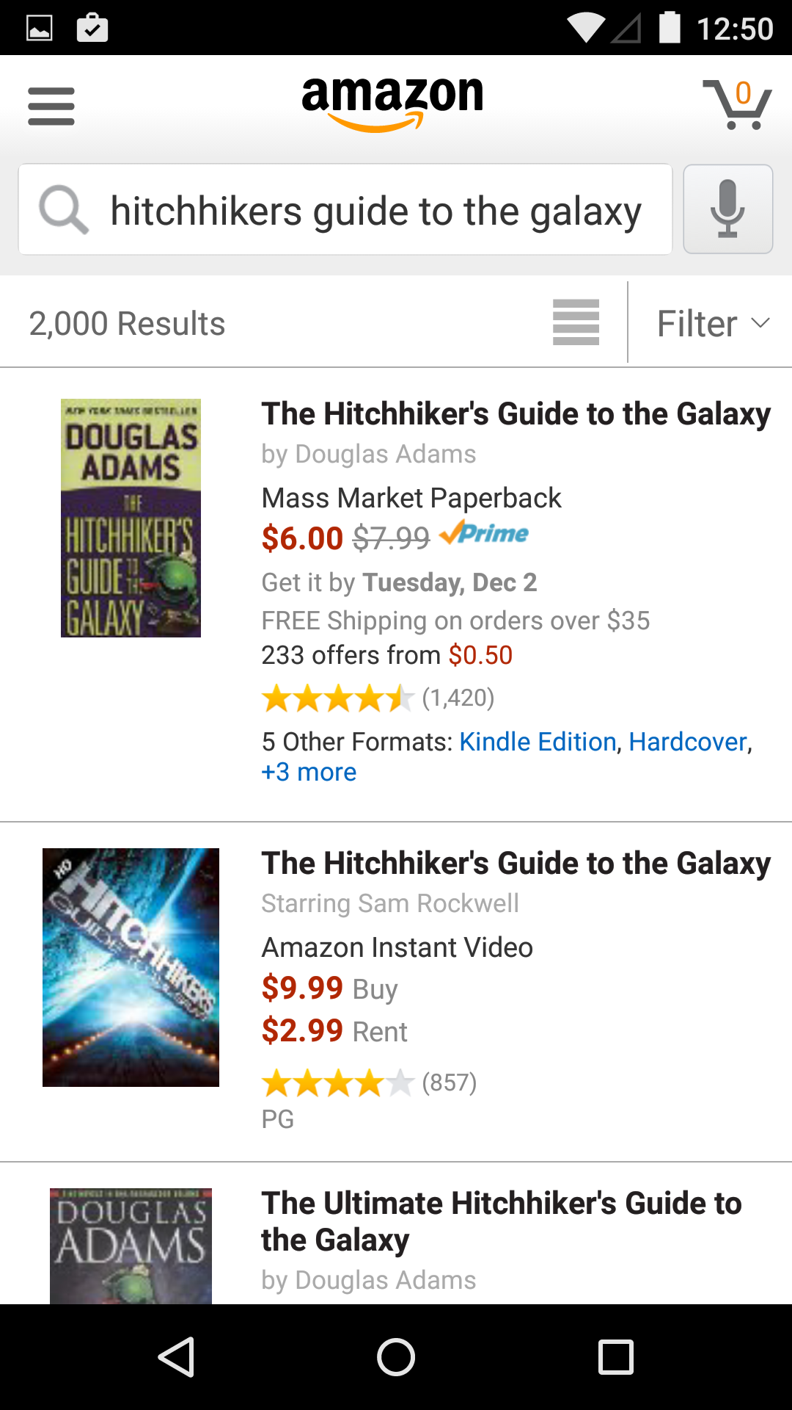
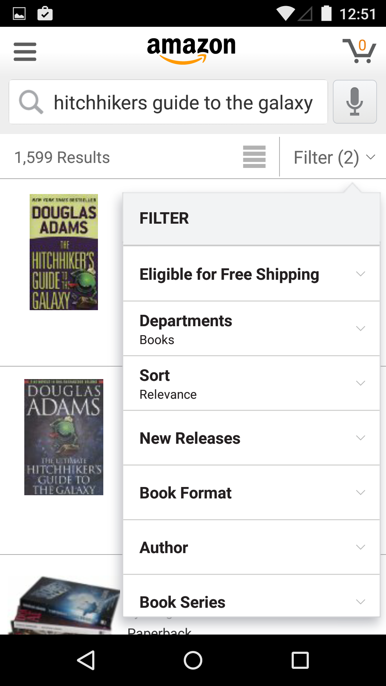
Notes:
Remember that end users do not see those diagrams. Don’t let anyone get worried about being confused by that, as long as the final interface doesn’t look confusing.
Do you know the IA of Amazon, or your favorite news source? Probably only a smattering of it. You know maybe that you should search on Amazon within books to make sure you can find the Hitch-Hikers Guide to the Galaxy book, instead of being flooded with results from that pretty mediocre movie.

Slide 17
Notes:
IA is not navigation, or wayfinding, but it can inform it. Like many news sources do, you can expose the categories not as tedious tab bars but as ways to Organize The Information organically. Users can find the story they are looking for, or the category of information.

Slide 18
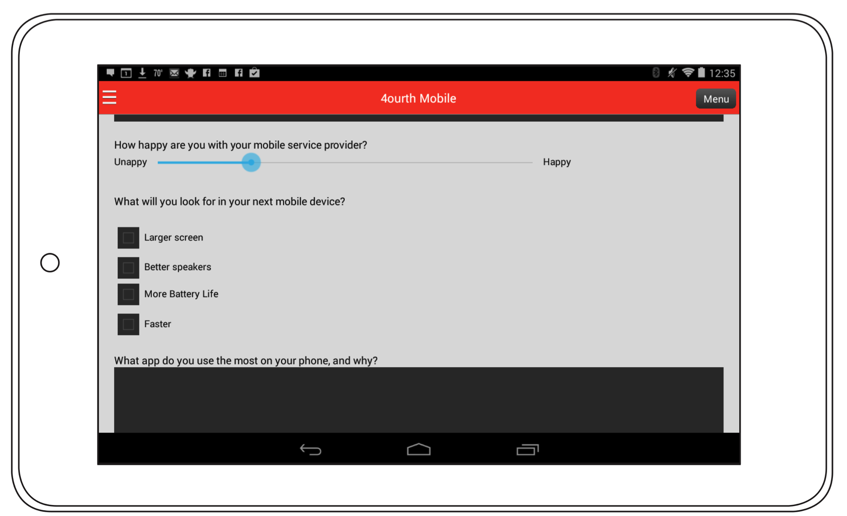
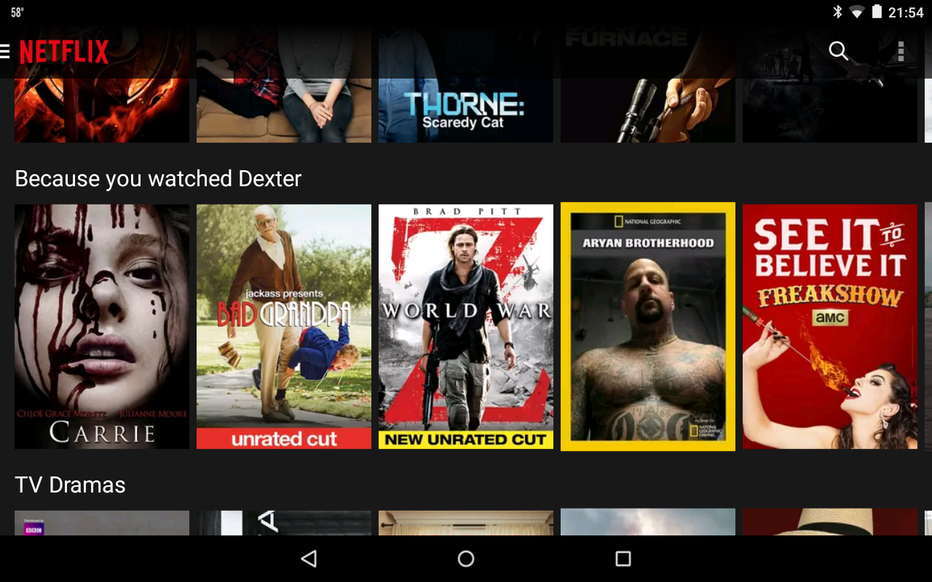
Notes:
I think we’re all familiar with how Netflix works as well like this. And here is a good example of complexity. Funny categories, and categories specific to your behavior can be exposed to make apparent how the system works, and help the user find content they want.

Slide 19
“…consider the “non-use-case”… Broadcasting a sound—particularly voices—into an empty room in the middle of the night can be both startling and annoying.”
– Dan Saffer
in Microinteractions
Notes:
Always be thinking of the end user. Not just what is a good feature, but what is an anti-good feature. Are you making your users do too much work you can do for them? Are you making them mistrust the system?
In a not-as-unusual case as you might expect, are you actually scaring them with how your system works? Even as pure Information Architecture that creepy-helpful scale can be tricky to balance out.

Slide 20
In Part 7:
Outside and Between
Messaging
Architecture of ecosystems
Custom URI
Notifications
Intents
Notes:
Next I want to keep talking about these same topics, but how they can be applied when your app or website isn’t even running, or you reach the limits of what it can do itself.

